Slide 1
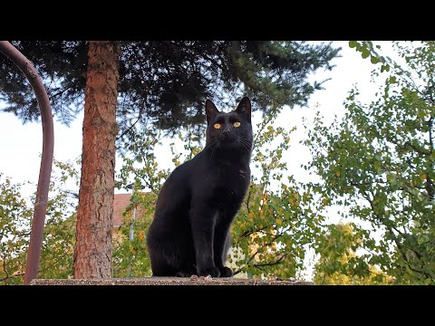
CSC384 TUT9101

Slide 2
CSC384:Intro to artificial intelligence
TUT9101 Thursdays 9:10-10AM

Slide 3
CSC384 Tutorial 4: Adversarial Search
Exercise 1
Minimax and Alpha Beta pruning alg review
Alpha Beta implementation
Trace tree together
Discuss
Exercise 2 break out groups
Discuss
Questions?
Toso vote

Slide 4
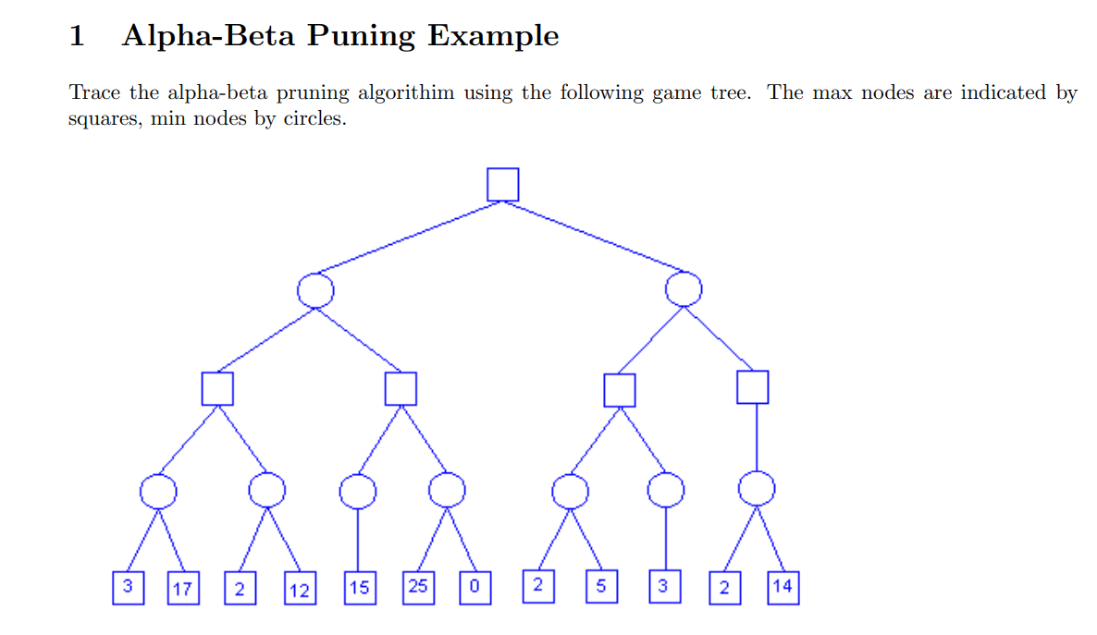

Slide 5
Minimax: setting up the tree
• Build full game tree (all leaves are terminals)
• Root is start state, edges are possible moves, etc.
• Label terminal nodes with utilities
• (only feasible for smaller games!)
• Back values up the tree
• U(t) is defined for all terminals (part of input)
• U(n) = min{U(c) : c is a child of n} if n is a Min node
• U(n) = max{U(c) : c is a child of n} if n is a Max node

Slide 6
Minimax strategy
• The values U(n) labeling each state n are the values that Max will achieve in that state if both Max and Min play their best moves.
• Minimax Strategy is:
• Max always plays a move to change the state to the highest valued child.
• Min always plays a move to change the state to the lowest valued child.

Slide 7
Alpha Beta Pruning
After generating value for only some of n’s children we can prove that we’ll never reach n in a Minimax strategy. So we needn’t generate or evaluate any further children of n! These other children can be pruned.
• Two types of pruning (cuts):
• pruning of max nodes (α-cuts) α is the highest value found so far (MAX wants this)
• pruning of min nodes (β-cuts) β is the lowest value found so far (MIN wants this)

Slide 8
Alpha cuts (MAX cuts)
• If α becomes ≥ β we can stop expanding the children of MAX node n
• Min will never choose to move from n’s parent to n since it would choose one of n’s lower valued siblings first.

Slide 9
Beta cuts (MIN cuts)
• If β becomes ≤ α we can stop expanding the children of MIN node n
• Max will never choose to move from n’s parent to n since it would choose one of n’s higher value siblings first.

Slide 10
Alpha Beta implementation
AlphaBeta(pos,alpha,beta):
#return best move for player(pos)
#and MAX’s value for pos
best_move = None
if terminal(pos):
return best_move, utility(pos)
if player(pos) == MAX: value = -infinity
if player(pos) == MIN: value = infinity
for move in actions(pos):
nxt_pos = result(pos, move)
nxt_val,nxt_move = AlphaBeta(nxt_pos, alpha, beta)
if player == MAX:
if value < nxt_val: value, best_move = nxt_val, move
if value >= beta: return best_move, value
alpha = max(alpha, value)
if player == MIN:
if value > nxt_value: value, best_move = nxt_val, move
if value <= alpha: return best_move, value
beta = min(beta, value)
return best_move, value
Initial call
AlphaBeta(START,-infinity,+infinity)

Slide 11
Let’s trace!

Slide 12
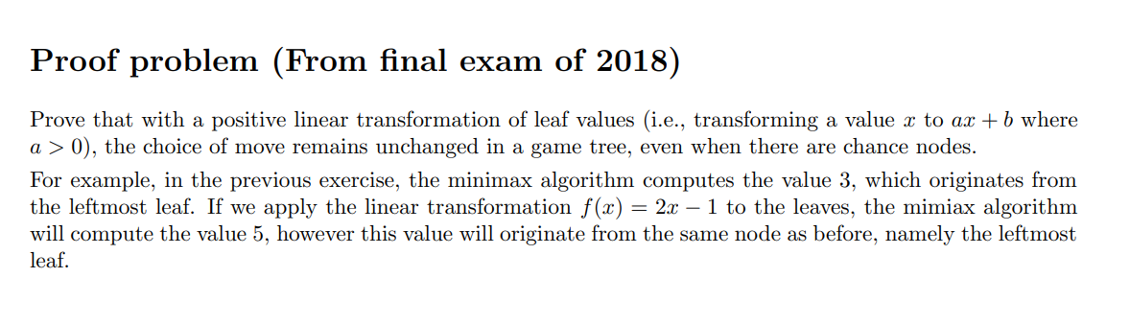

Slide 13
Proof:
The general strategy is to reduce a general game tree to a one-ply tree by induction on the depth of the tree. The inductive step must be done for min, max, and chance nodes, and simply involves showing that the transformation is carried through the node. Suppose that the values of the descendants of a node are x1 . . . xn, and that the transformation is ax+b, where a is positive. We have
min(ax₁ + b, ax₂ + b, . . . , ax_{n} + b) = amin(x₁, x₂, . . . , x_{n}) + b
max(ax₁ + b, ax₂ + b, . . . , ax_{n} + b) = amin(x₁, x₂, . . . , x_{n}) + b
p1(ax₁ + b) + p2(ax₂ + b) + · · · + pn(ax_{n} + b) = a(p₁x₁ + p₂x₂ + · · · p_{n}x_{n}) + b
Hence the problem reduces to a one-ply tree where the leaves have the values from the original tree multiplied by the linear transformation. Since x > y ⇒ ax + b > ay + b if a > 0, the best choice at the root will be the same as the best choice in the original tree.

Slide 14
Any questions?

Slide 15
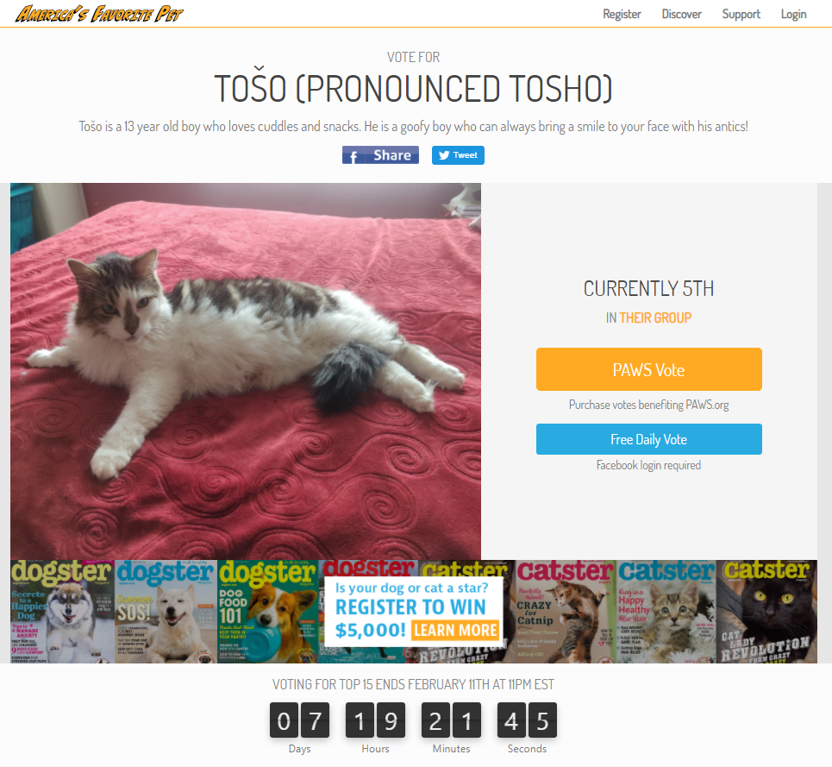
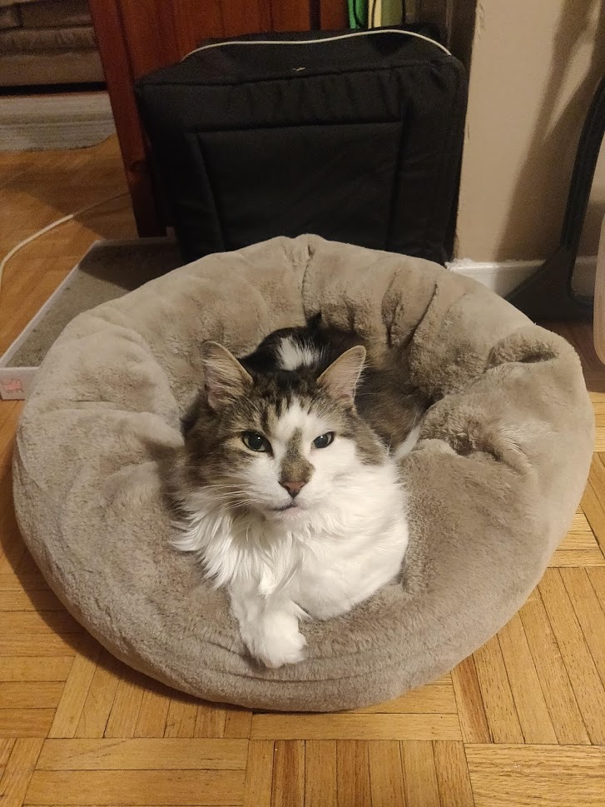
Pls consider voting for Toso for America’s favourite pet!
I will put link in chat if you would like to vote!

